Slide 1
ETL Project: NYC Dog Analysis
Emily Todd

Slide 2
Project Proposal
Analyze the NYC dog license data to find interesting trends in names by geography
Compare against the tree census to find the region with the most trees for dogs to enjoy
Finding Data
https://opendata.cityofnewyork.us/data/
Dog Licenses: https://data.cityofnewyork.us/Health/NYC-Dog-Licensing-Dataset/nu7n-tubp
Tree Census: https://data.cityofnewyork.us/Environment/2015-Street-Tree-Census-Tree-Data/pi5s-9p35

Slide 3
Data Cleanup & Analysis
The sources of data that you will extract from
2 CSV files
NYC_Dog_Licensing_Dataset
2015StreetTreesCensus_TREES
The type of transformation needed for this data (cleaning, joining, filtering, aggregating, etc.)
[Detailed data transformation on following slides]
The type of final production database to load the data into (relational or non-relational)
PostgreSQL, relational database
The final tables or collections that will be used in the production database.
Database: dog_db
Tables: dog_names, nyc_trees

Slide 4
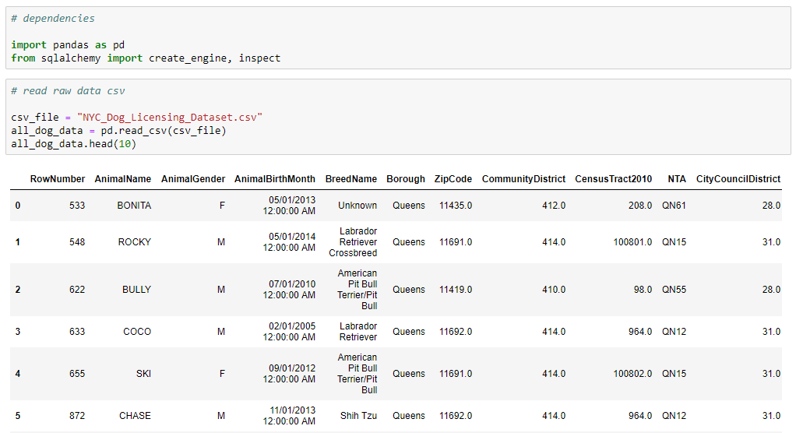
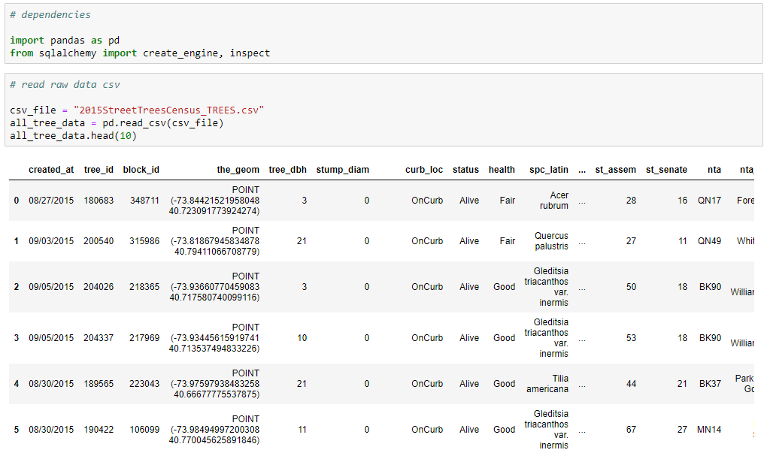
Extract
Each CSV file was imported and saved as a Pandas data frame

Slide 5
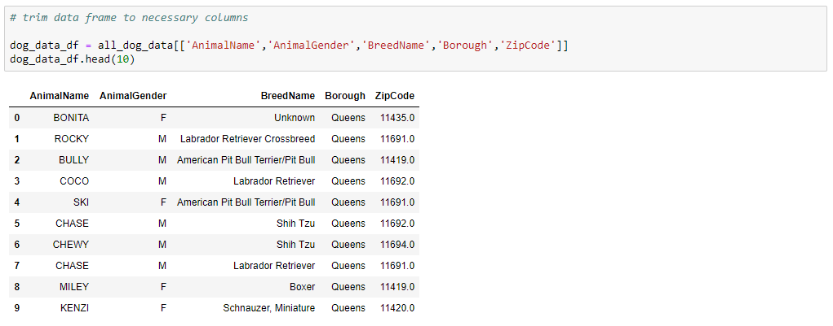
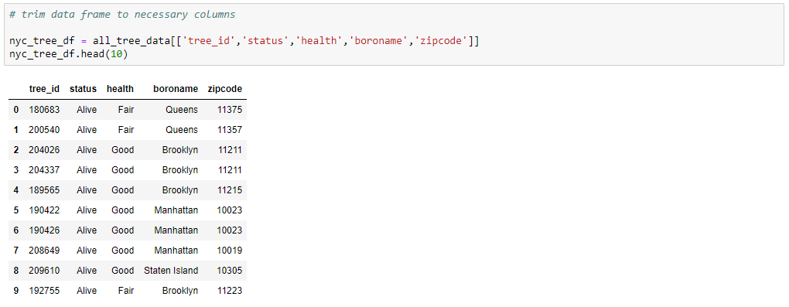
Transform
Data frames were trimmed to include only useful columns

Slide 6
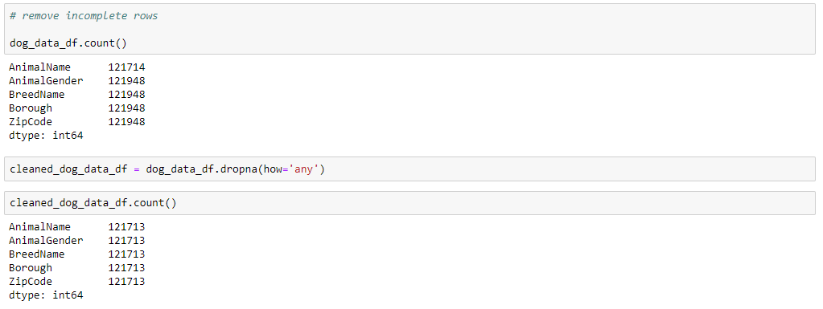
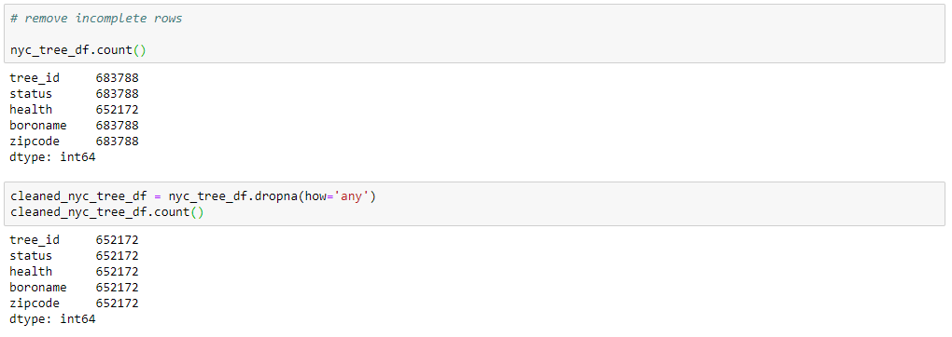
Transform
Incomplete rows were removed

Slide 7


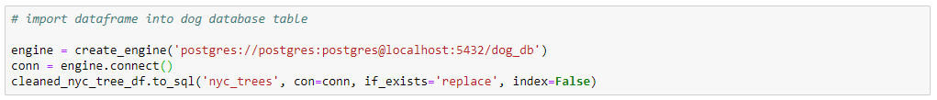
Load
Dog Database was created with SQLAlchemy engine and both tables were added

Slide 8
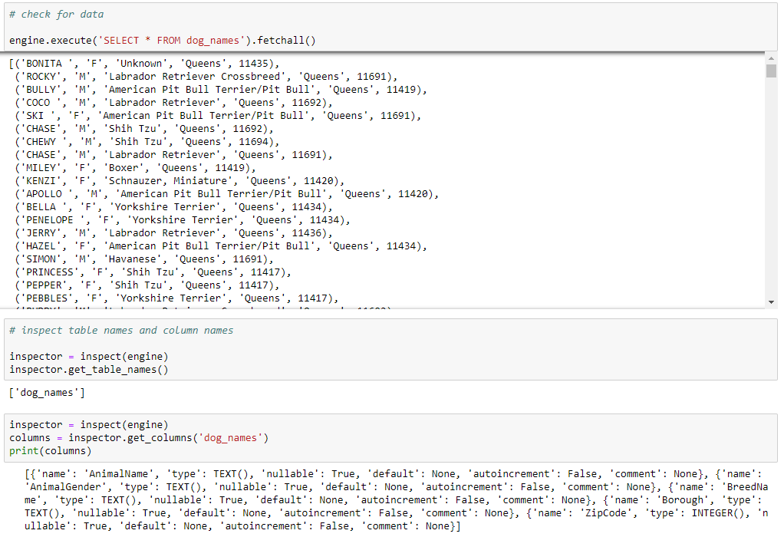
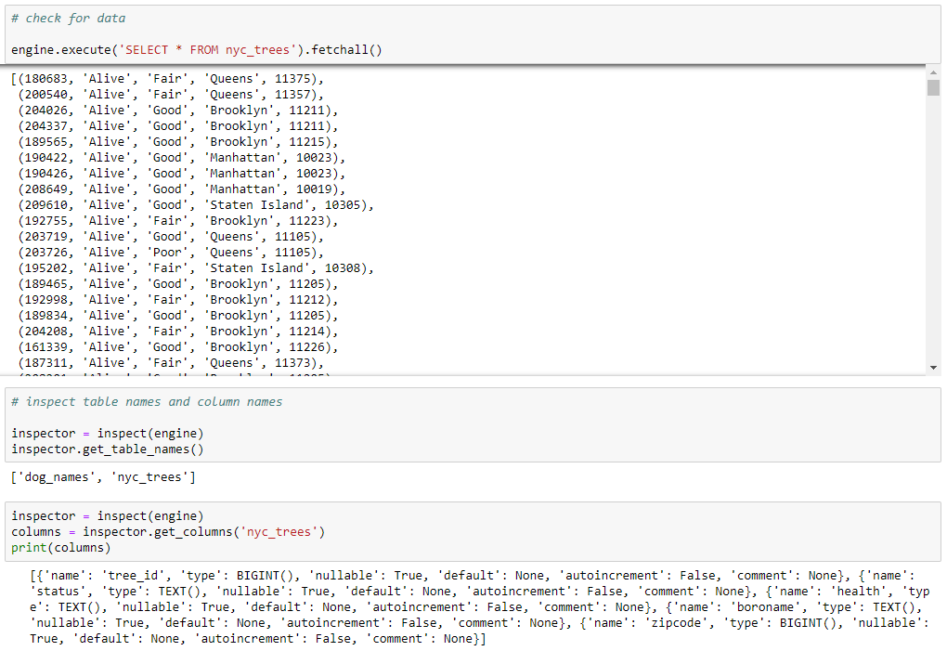
Load
Validated that data loaded correctly

Slide 9
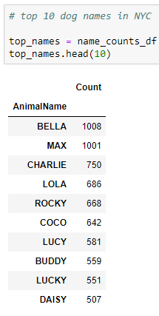
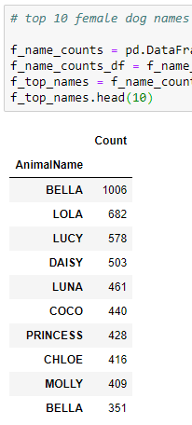
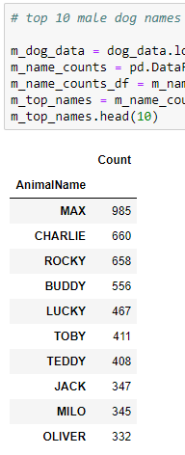
Analysis
Top 10 dog names in NYC
Bella and Max are the most popular dog names in NYC with around 1,000 licenses each
Within the top 10 there is an even distribution of female and male names

Slide 10
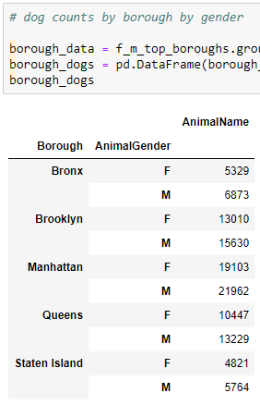
Analysis
Dog counts by NYC borough
All five boroughs have more male dogs than female dogs
Manhattan has the most dogs, but is ranked 3rd in residents (behind Brooklyn and Queens)

Slide 11
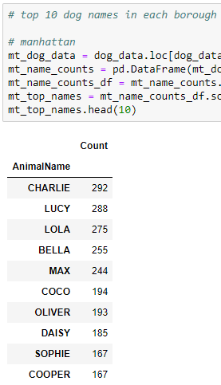
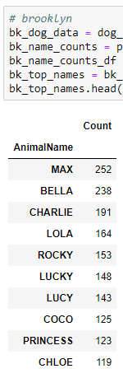
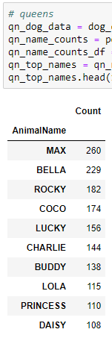
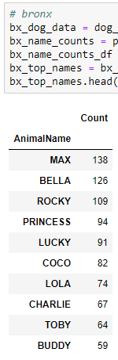
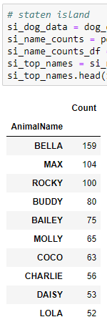
Analysis
Top 10 dog names by borough
There are strong similarities in dog names between boroughs
Max and Bella are the top 2 in every borough except Manhattan, where they’re 4 and 5

Slide 12
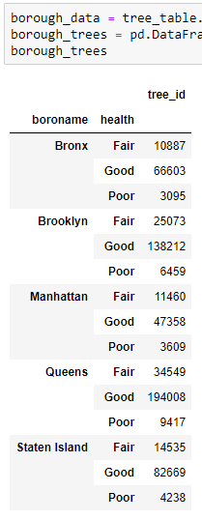
Analysis
For a happy dog, I’ve also included a summary of each borough’s tree count and condition
Though it’s home to the most dogs, Manhattan has the fewest trees
Dogs should consider visiting Queens to take advantage of the highest number of trees

